Slide 1
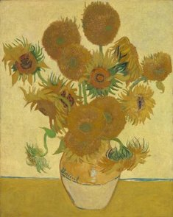
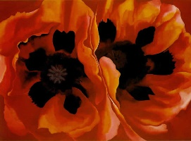
Theme and Idea development
Figuring the themes and ideas that I am conveying to the audience was something that was quite apparent. Some of my artworks revolve around the contrast of urban and natural environments. I am constantly observing this contrast and you can see that being shown in my artworks. I also observe the effect these environments have on me and how they have impacted me. This causes a lot of self-reflection and I am able to express the reflection of my own personal nature through my art. Starting off, I started to work with two-dimensional pieces such as paintings, because that is what I believed was the norm for an “art student” at the time. I used brushes of different sizes and canvases of several sizes. One of my pieces was a tryptic, and the goal of this project was to express the artist, how the city has impacted the artist, and the effect the artist has on the city.
I first started making my art revolved around nature; more specifically flowers. I grew up in a household where flowers were extremely treasured and I was constantly being pointed towards the beauty of them. Flowers and plants are usually seen as just pretty things but there is so much more. Through art, I was able to explore many different artist that used flowers and nature as a major element. The artists have influenced to create some of the works I have created. Two specific artists are Vincent Van Gogh and Georgia O’Keefe. Van Gogh’s series with sunflowers hit close to home for me since my earliest memory of being close to a flower was a sunflower. I just marveled at the size and the beauty it had. And then there’s Georgia O’Keefe who was an artist that creates very symbolic pieces that relate to the female nature. She showed me that flowers are more than just another daily think you see. They have meaning and allow lots of room for interpretation.

Slide 2
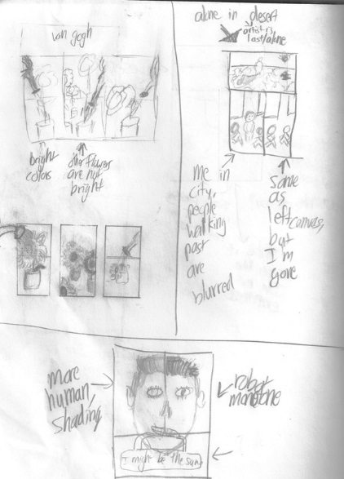
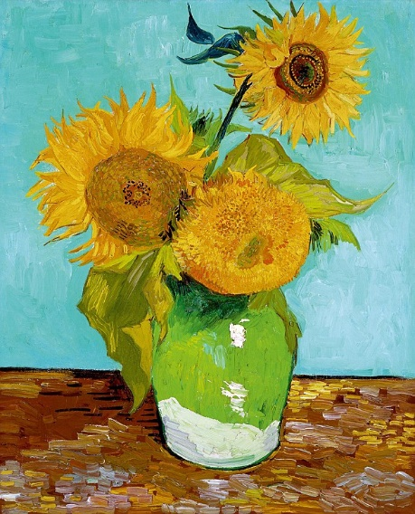
Communications of Ideas and Intentions
Artist as a Sunflower

Slide 3
Process and Development
Artist as a Sunflower

Slide 4
Communication of Ideas and Intentions
Beginnings & Endings

Slide 5
Process and Development
Beginnings & Endings

Slide 6
Communication of Ideas and Intentions
Bleak Thoughts
Cardboard

Slide 7
Process and Development
Bleak Thoughts

Slide 8
Communication of Ideas and Intentions
Civil

Slide 9
Gallery Visit
Artist as a Sunflower
Oil Milwaukee

Slide 10
Process and Development
Civil

Slide 11
General Overview Thus Far
Painting Overall
Discuss the medium of painting and then talk about the new mediums that are to come. (Printing, 3D, and digital art with tablets)

Slide 12
Communication of Ideas and Intentions
Iced Flowers

Slide 13
Process and Development
Iced Flowers

Slide 14
Communication of Ideas and Intentions
Urban Landscape

Slide 15
Process and Development
Urban Landscape

Slide 16
Communication of Ideas and Intentions
Lit Roses

Slide 17
Process and Development
Lit Roses

Slide 18
Communication of Ideas and Intentions
Arrival
Add a section about lens based work

Slide 19
Process and Development
Arrival

Slide 20
Communication of Ideas and Intentions
Milwaukee Flag
Briefly talk about digital art

Slide 21
Process and Development
Milwaukee Flag

Slide 22
Communication of Ideas and Intentions
Triangular Orchid
Talk about the experience over summer, talk about where, instructor, and all the good stuff

Slide 23
Process and Development
Triangular Orchid

Slide 24
Communication of Ideas and Intentions
Know Thyself

Slide 25
Process and Development
Know Thyself
Add a conclusion about the work done in the past two years

